Slide 1
Garbage Collection and Memory Leak Avoidance in .NET
Yuriy Shapovalov
Senior Software Engineer, EPAM (Kharkov)

Slide 2
Agenda
Garbage Collection in .NET 4.5
How memory leaks affect enterprise applications.
Memory Leak root causes.
Memory profiling and memory leak detection tools.

Slide 3

Tracing GC algorithm
Garbage collection algorithm in .NET is based on Tracing Algorithms (McCarthy, 1960) which was developed for Lisp language.
Also known as “Mark and Sweep”
Stop all processes, run garbage collector
Trace forward from the roots
Everything touched is live, anything else is garbage.

Slide 4
Tracing GC algorithm
Every application has a set of roots:
Static variables
CPU registers
Active local variables and stack roots
roots
static
active variables
CPU registers
Managed Heap

Slide 5
Tracing GC algorithm
roots
static
active variables
CPU registers
Managed Heap
Native Heap

Slide 6
Tracing GC algorithm
roots
static
active variables
CPU registers
Managed Heap
Native Heap

Slide 7
Tracing GC algorithm
roots
static
active variables
CPU registers
Managed Heap
Native Heap

Slide 8
Tracing GC algorithm
roots
static
active variables
CPU registers
Managed Heap
Native Heap

Slide 9
Tracing GC algorithm
roots
static
active variables
CPU registers
Managed Heap
Native Heap

Slide 10
Generations
Younger objects dies faster
Older objects live longer
Garbage collection works faster for part of the heap, than for whole heap.
GLR has 3 generations:
0 – for new objects
1 – for old objects
2 – for the oldest

Slide 11
Generations
a
b
c
d
e
0
a
b
c
d
e
0
a
b
d
1
0

Slide 12
Generations
a
b
d
f
g
h
i
j
k
1
0
a
b
d
f
g
h
i
j
k
1
0
a
d
g
i
2
1
0

Slide 13
Finalization
GC can be called in following cases
Generation 0 is full
Explicit call static method GC.Collect()
Although Microsoft does not recommend to do that, sometime it make sense to force collecting.
Unload application domain.
CLR treat that application has no roots anymore.
Closing CLR
CLR tries to call Finalize() for each object in managed heap

Slide 14
Finalization
roots
static
active variables
CPU registers
Managed Heap
d
a
b
c
e
Native Heap

Slide 15
Finalization
roots
a
static
active variables
CPU registers
b
c
Managed Heap
a
b
c
Native Heap
Finalization queue
F-reachable queue

Slide 16
Finalization
roots
a
static
active variables
CPU registers
b
c
Managed Heap
a
b
c
Native Heap
Finalization queue
F-reachable queue

Slide 17
Finalization
roots
a
static
active variables
CPU registers
Managed Heap
b
c
a
b
c
Native Heap
Finalization queue
F-reachable queue

Slide 18
Finalization
roots
a
static
active variables
CPU registers
Managed Heap
c
a
c
Native Heap
Finalization queue
F-reachable queue

Slide 19
Finalization
roots
a
static
active variables
CPU registers
Managed Heap
a
Native Heap
Finalization queue
F-reachable queue

Slide 20
Finalization
Finalization can be called in following cases
Generation 0 is full
The most common way to call Finalize().
Explicit call static method GC.Collect()
Although Microsoft does not recommend to do that, sometime it make sense to force collecting.
Unload application domain.
CLR treat that application has no roots anymore.
Closing CLR
CLR tries to call Finalize() for each object in managed heap

Slide 21
Memory Leak Types
Memory leak in managed heap
Unintended reference keeping managed object alive
Memory leak in unmanaged heap
Resource disposing omitting

Slide 22
Memory Leak Types
Memory leak in managed heap
Unintended reference keeping managed object alive
Memory leak in unmanaged heap
Resource disposing omitting

Slide 23
Profiling Tools
MemProfiler (SciTech Software)
http://memprofiler.com/
dotTrace Memory (JetBrains)
http://www.jetbrains.com/profiler/
ANTS Performance Profiler 8 (Redgate)
http://www.red-gate.com/products/dotnet-development/ants-performance-profiler/
WinDbg.exe + SOS

Slide 24
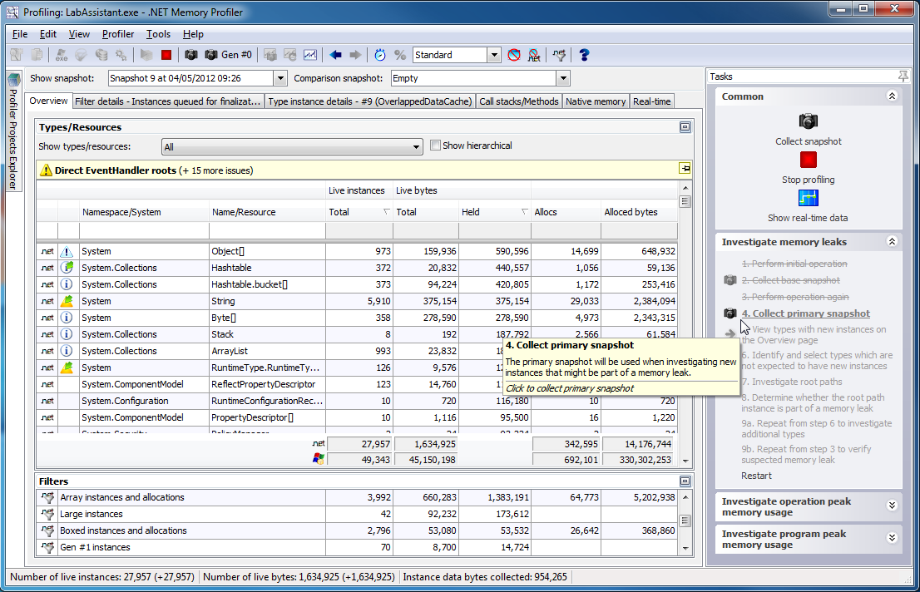
Profiling Tool: MemProfiler
Highly focused on memory profiling and leak detection.
Rich User interface.
Can work on production server and generate reports.

Slide 25
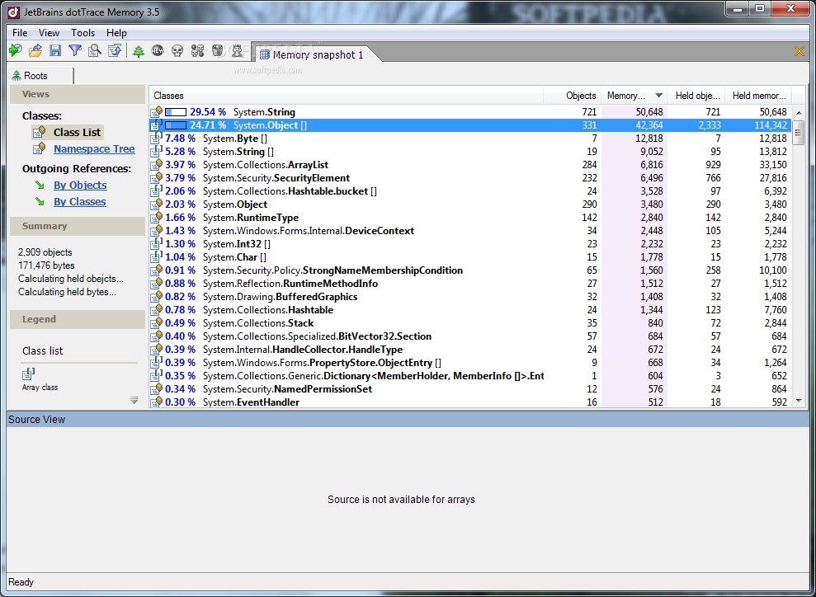
Profiling Tool: dotTrace Memory
Very convenient data representation, easy to use.
Provide referencing to source code which is cause memory leak.

Slide 26
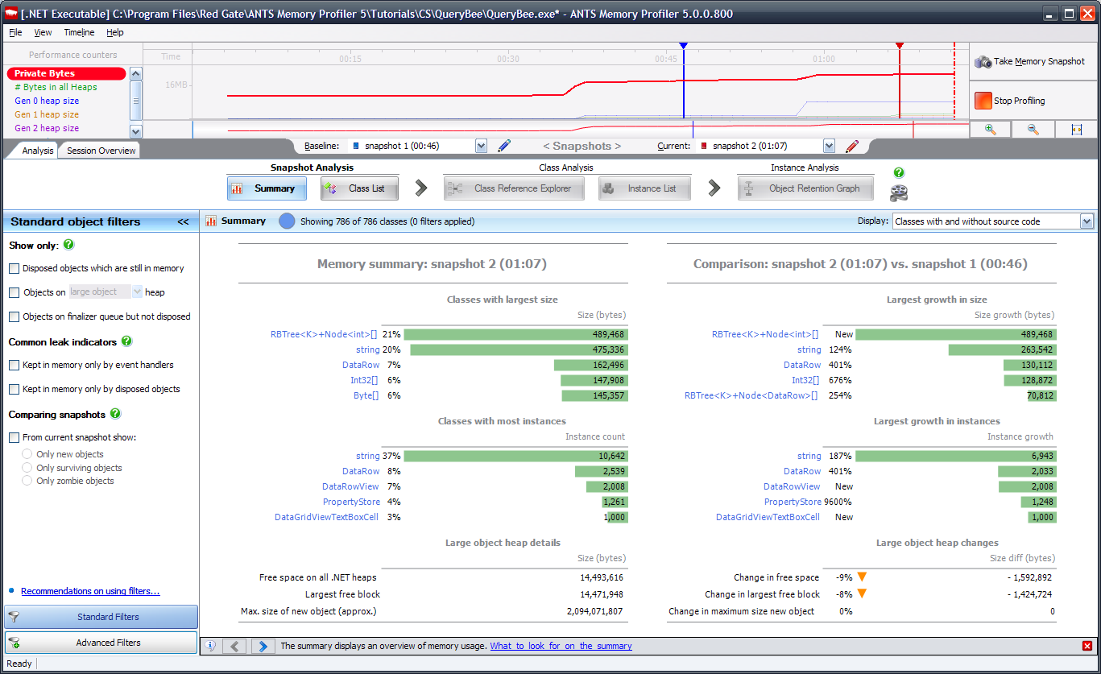
Profiling Tool: MemProfiler
Many useful features for memory consumption, and performance analysis.
Have data access profiling in latest version.

Slide 27
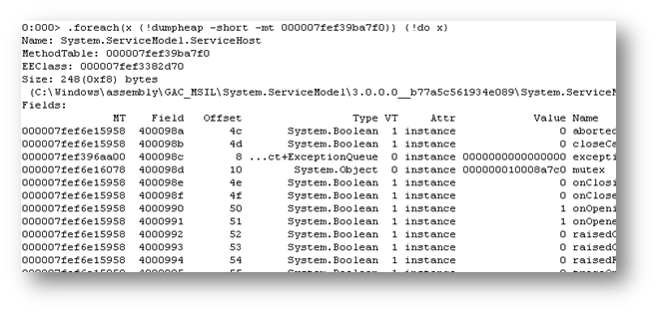
Profiling Tool: MemProfiler
Easy and free.
Integrated in Visual Studio
Command based interface.
Good for quick initial memory profiling.

Slide 28
Yuriy Shapovalov
Senior Software Engineer, EPAM (Kharkov)
yurii_shapovalov@epam.com
shapovalov.yuriy
linkedin.com/in/yuriyshapovalov
@YuriyShapovalov

